Slide 1
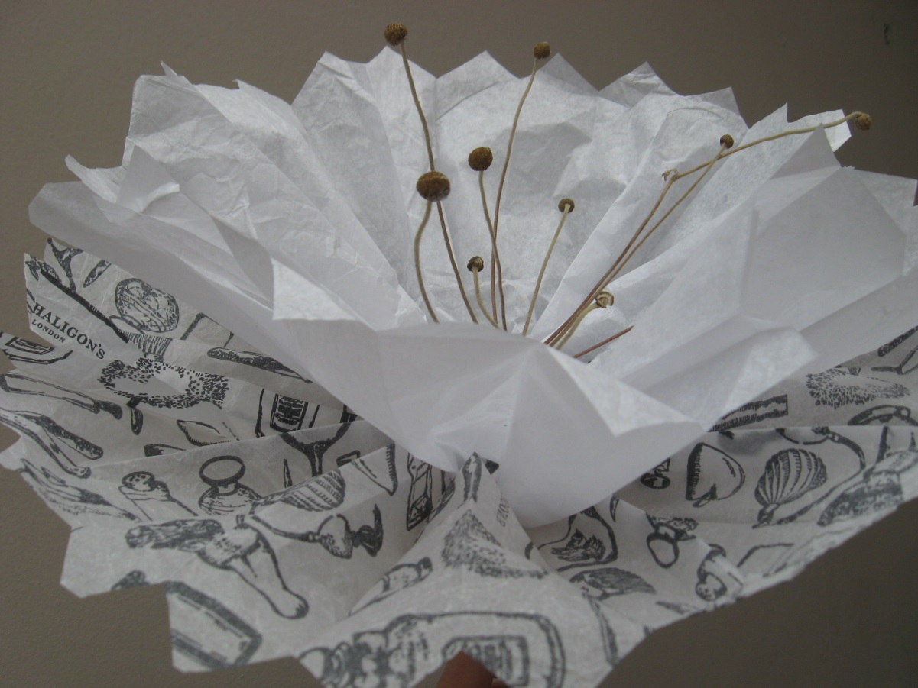
Make a paper flower with Ms Enoch

Slide 2
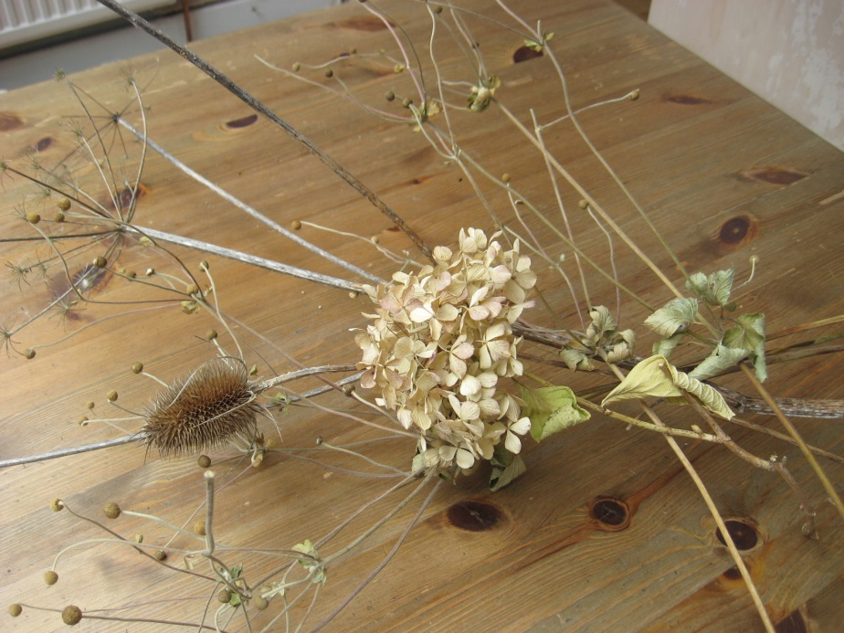
1. Collect some tissue paper, dried flowers, wire and tape
I used tissue from old wrapping, collected dried flowers from the garden and wire from an old notebook

Slide 3
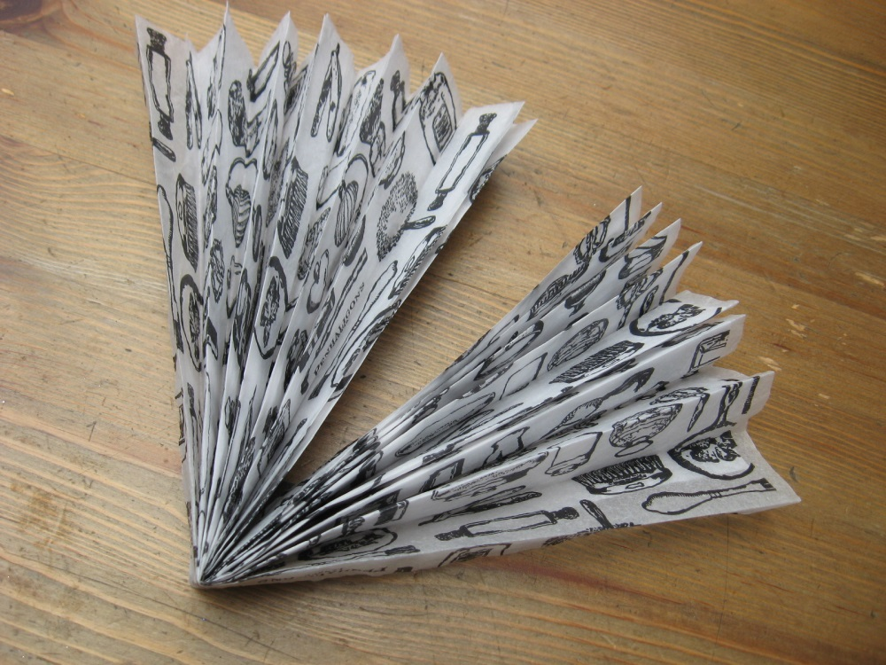
2. Using 2 rectangles of paper, fold 3cm concertina pleats on the short edge, all the way to the end and fold in half
Paper can be any size, mine is about
30 x 50cm

Slide 4
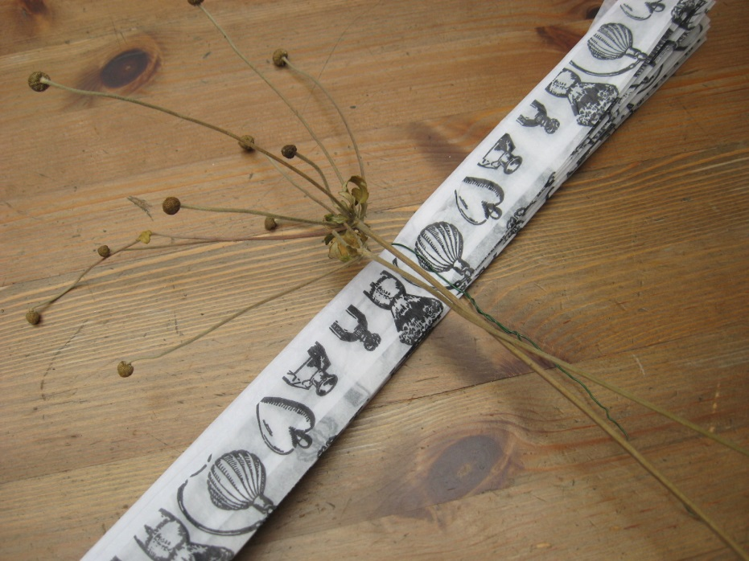
3. Twist a small piece of wire around the centre, lay your dried flower over this, then wrap the wire around the stick

Slide 5
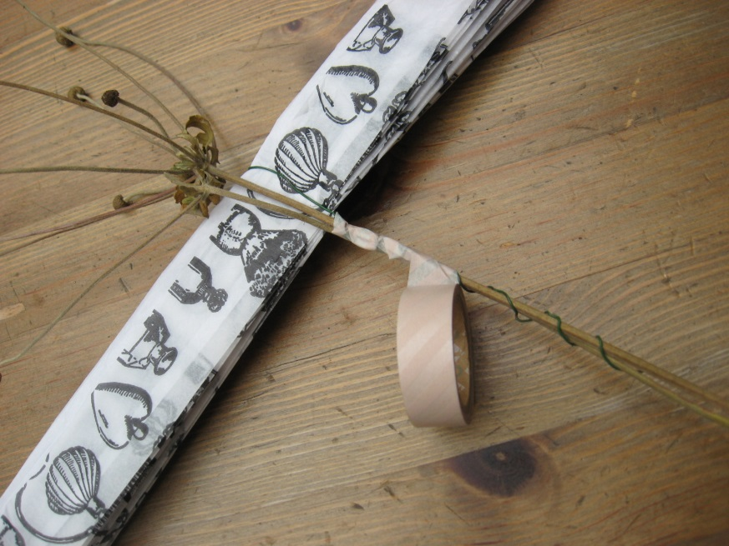
4. Wrap tape around the stick and wire

Slide 6
5. Cut either end to a point or scallop

Slide 7
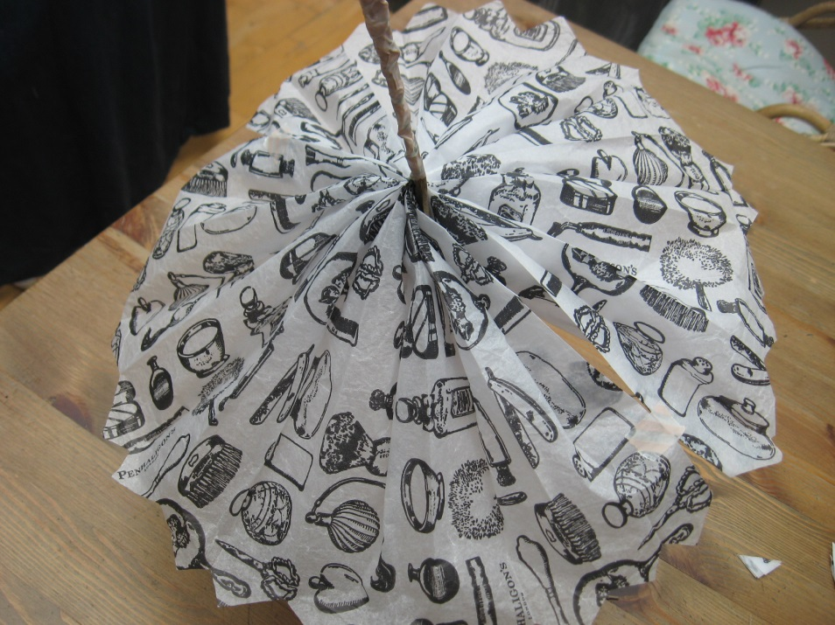
6. Carefully open up your concertina, separating the two layers and tape the sides together

Slide 8
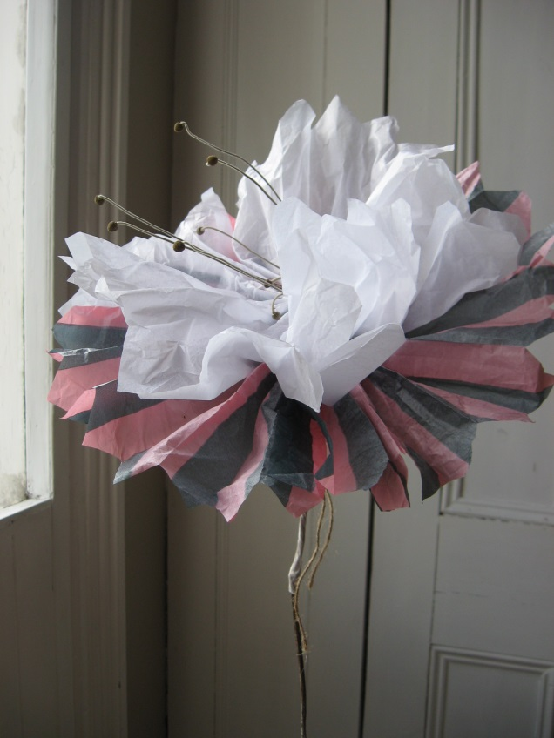
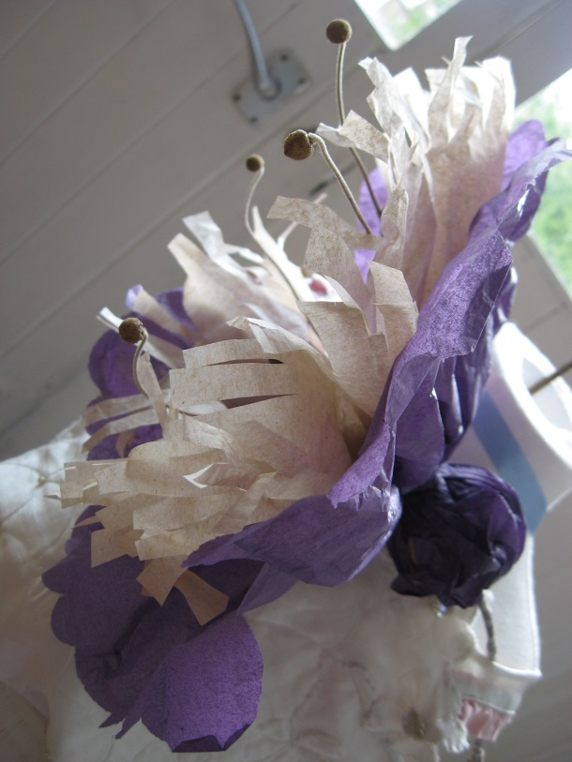
Make more in all colours with more layers for a full bouquet!

